Slide 1
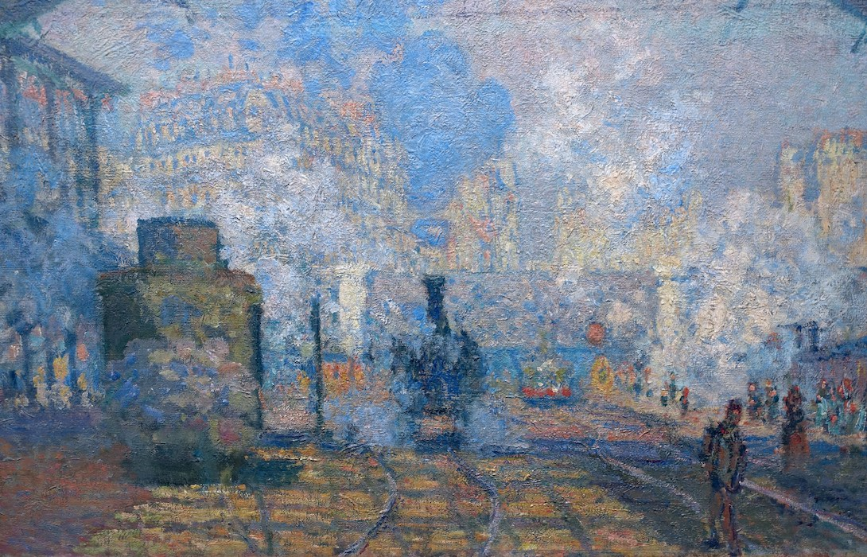
IMPRESSIONISM
History of Modern Art
BFA-III (Visual Arts)
Course Incharge: Ms. Sidra Liaqat
Institute of Design & Visual Arts, LCWU

Slide 2
IMPRESSIONISM
Interest in light, movement, spontaneity, fragmentation &
disintegration of form by light & shadow.
Leading artists of IMPRESSIONISM from France
Édouard Manet (1832 – 1883)
Claude Monet (1840 – 1926)
Pierre-Auguste Renoir (1841 – 1919)
Camille Pissarro (1830 – 1903)
Alfred Sisley (1839 – 1899)
Edgar Degas (1834 – 1917)

Slide 3
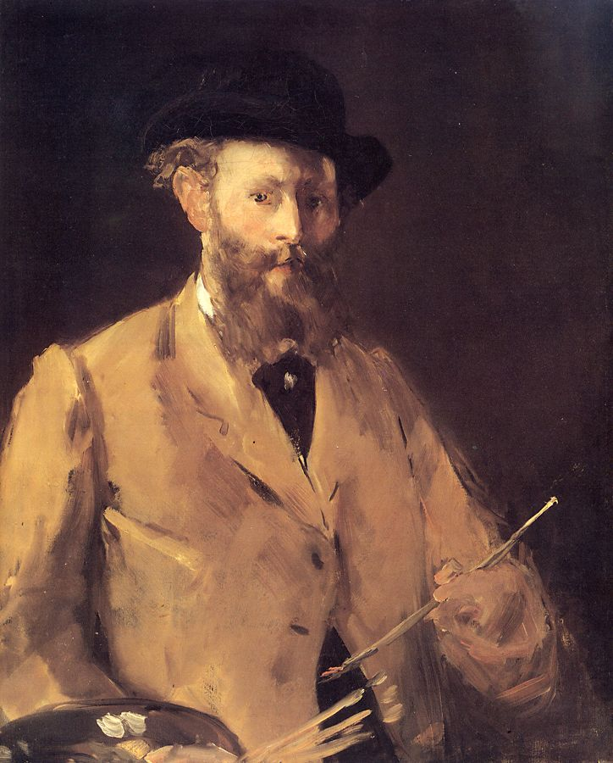
ÉDOUARD MANET (1832 – 1883)

Slide 4
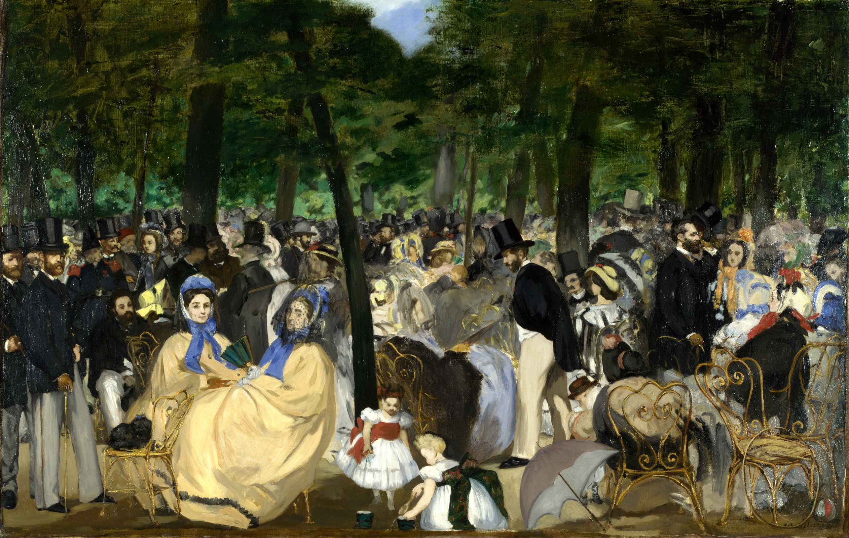
ÉDOUARD MANET
“Music in the Tuileries Gardens”
(1862)

Slide 5
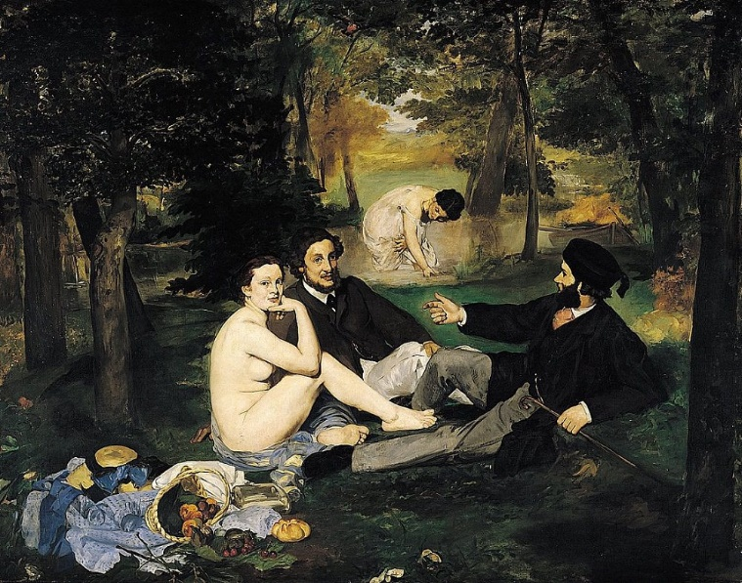
Exhibited at Salon des Refusés and was harshly criticized.
Based on Renaissance prototype.
ÉDOUARD MANET
“The Picnic” /
“The Luncheon on the Grass”
(1863)

Slide 6
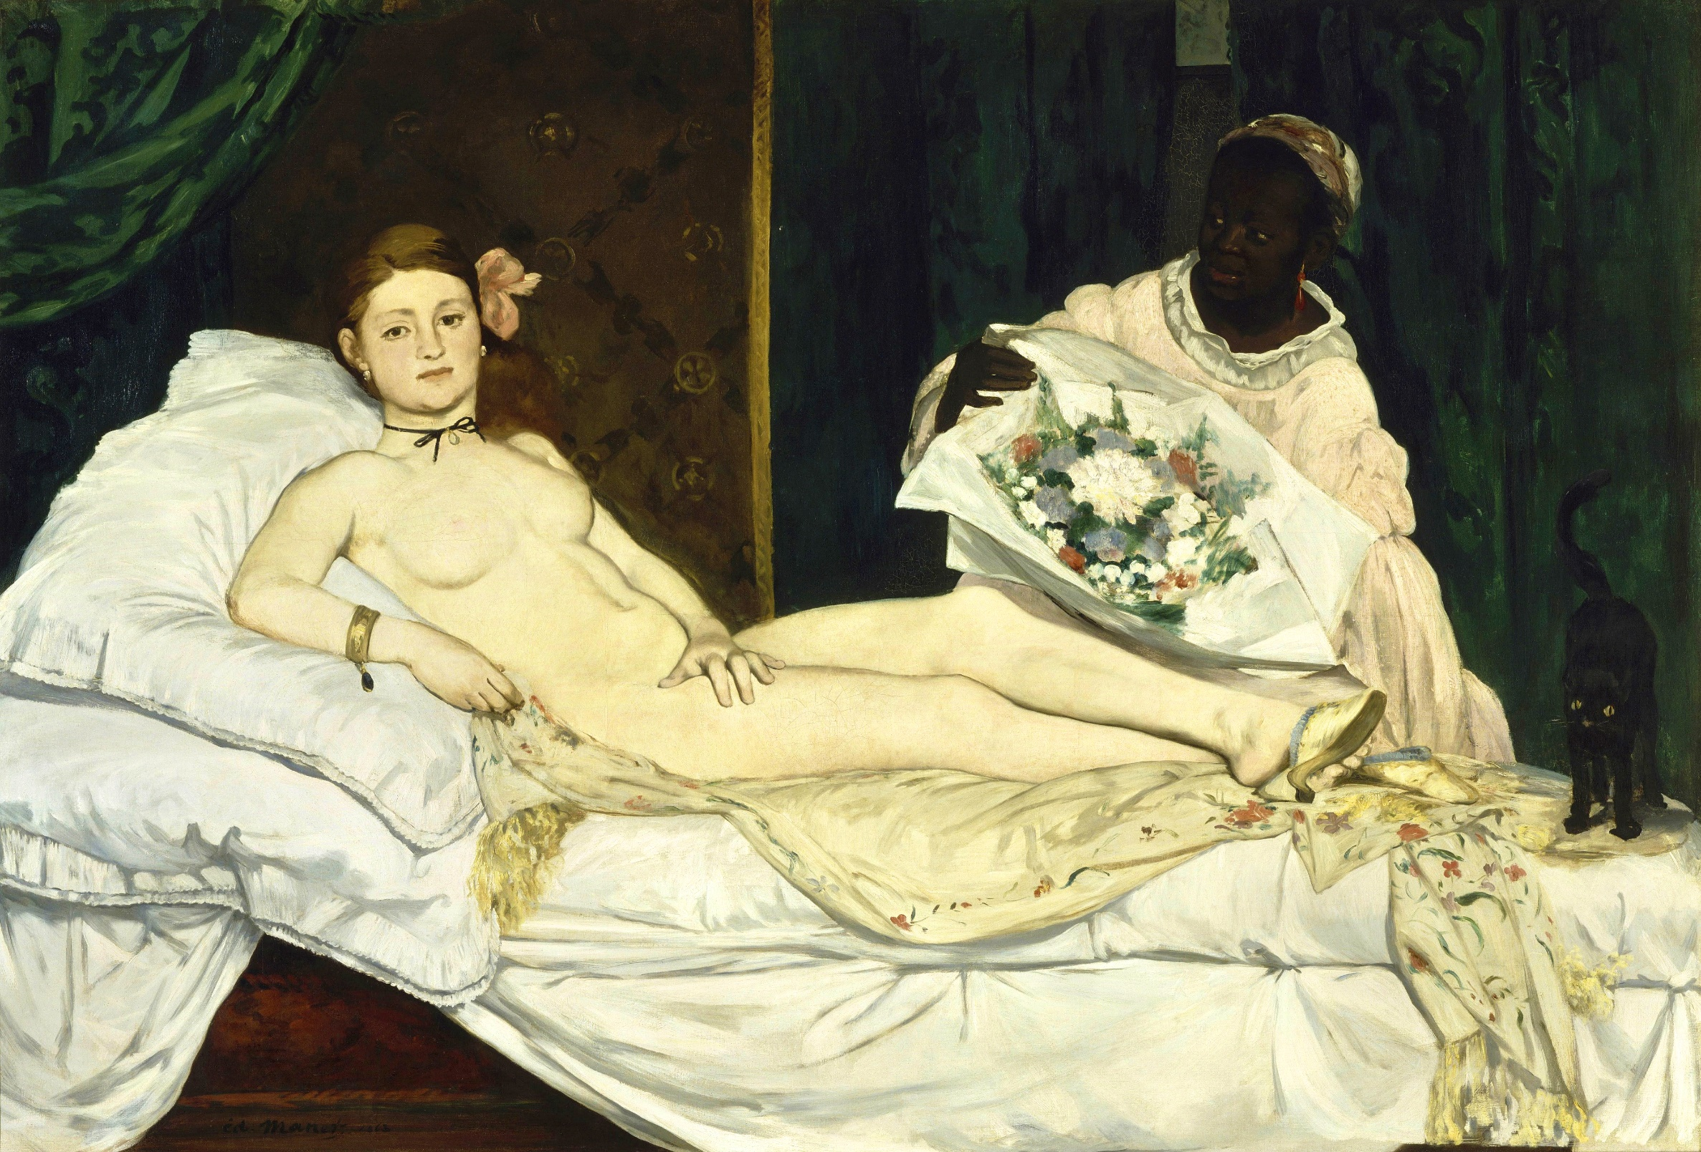
Faced severe criticism.
Based on Renaissance prototype.
ÉDOUARD MANET
“Olympia”
(1863)

Slide 7
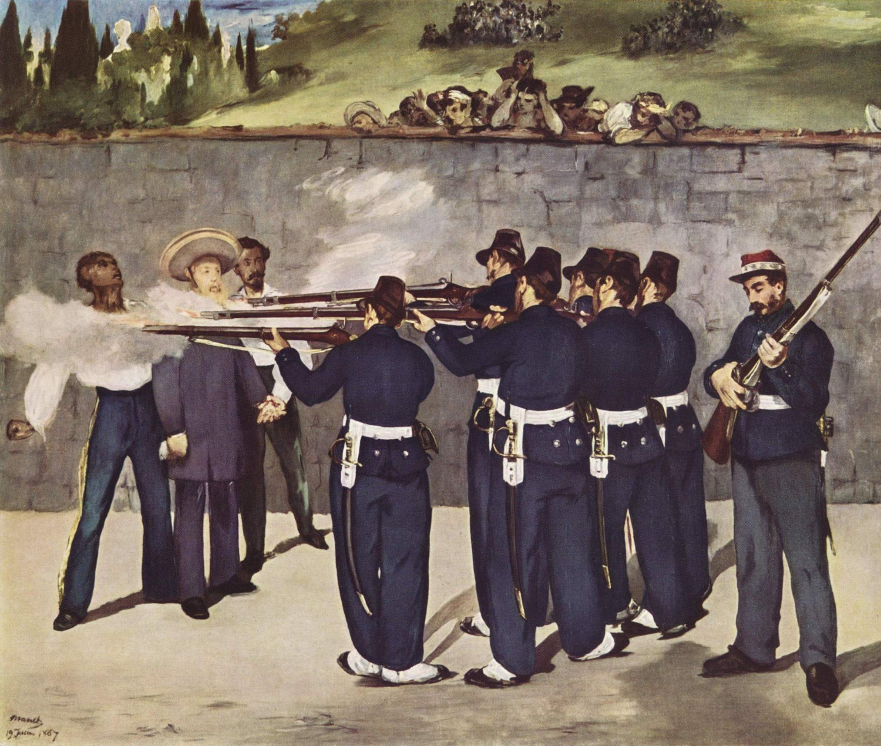
ÉDOUARD MANET
“The Execution of Emperor Maximillian of Mexico”
(1868)

Slide 8
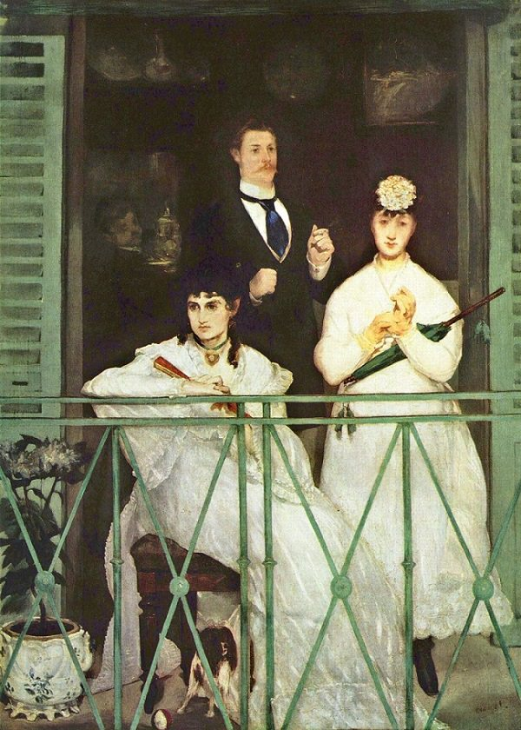
ÉDOUARD MANET
“The Balcony”
(1868)

Slide 9
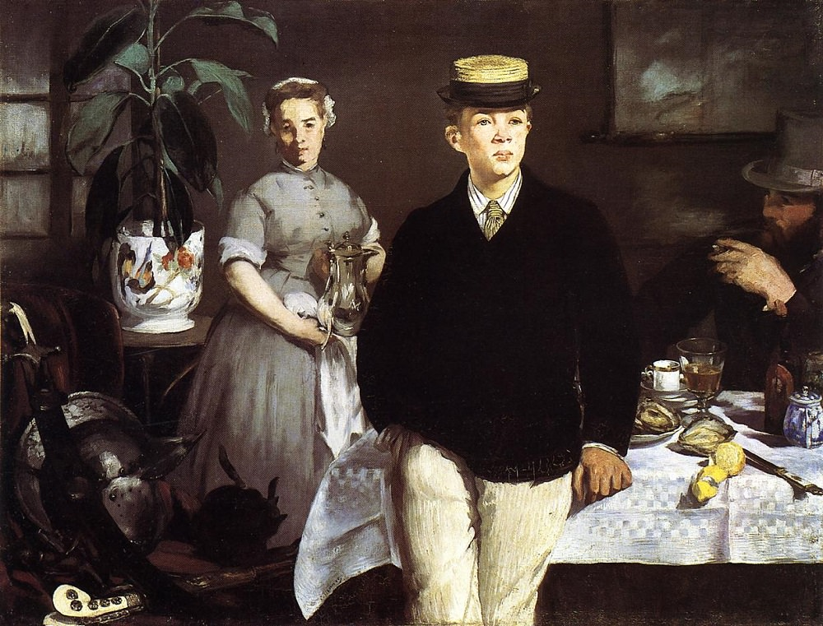
ÉDOUARD MANET
“Luncheon in the Studio”
(1868)

Slide 10
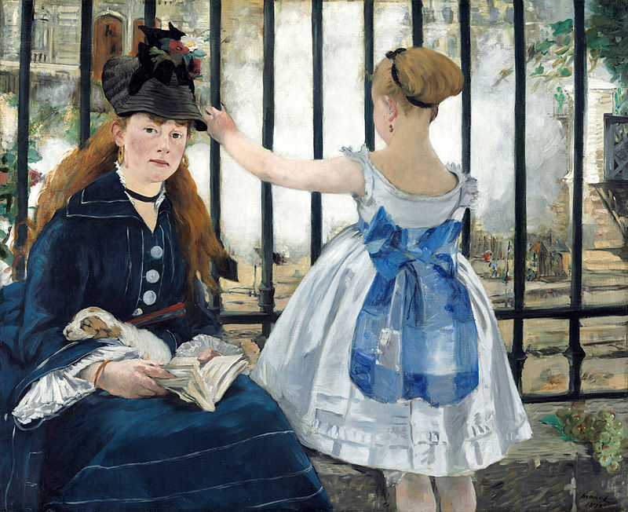
ÉDOUARD MANET
“The Railway”
(1873)

Slide 11
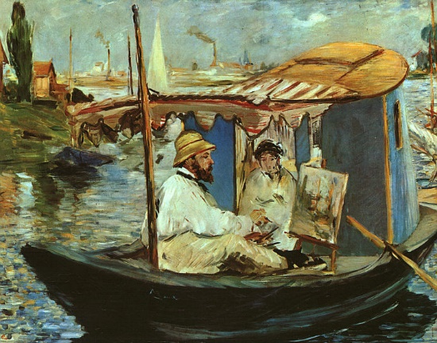
ÉDOUARD MANET
“Claude Monet Painting on his Studio Boat”
(1874)

Slide 12
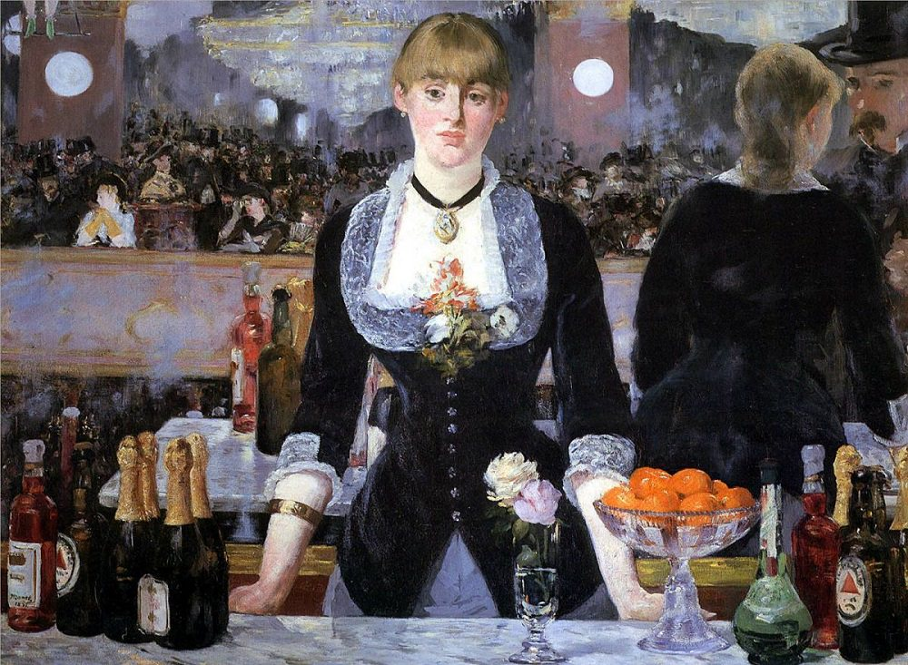
Last major work.
Displayed in the Salon.
ÉDOUARD MANET
“A Bar at the Folies-Bergère”
(1882)

Slide 13
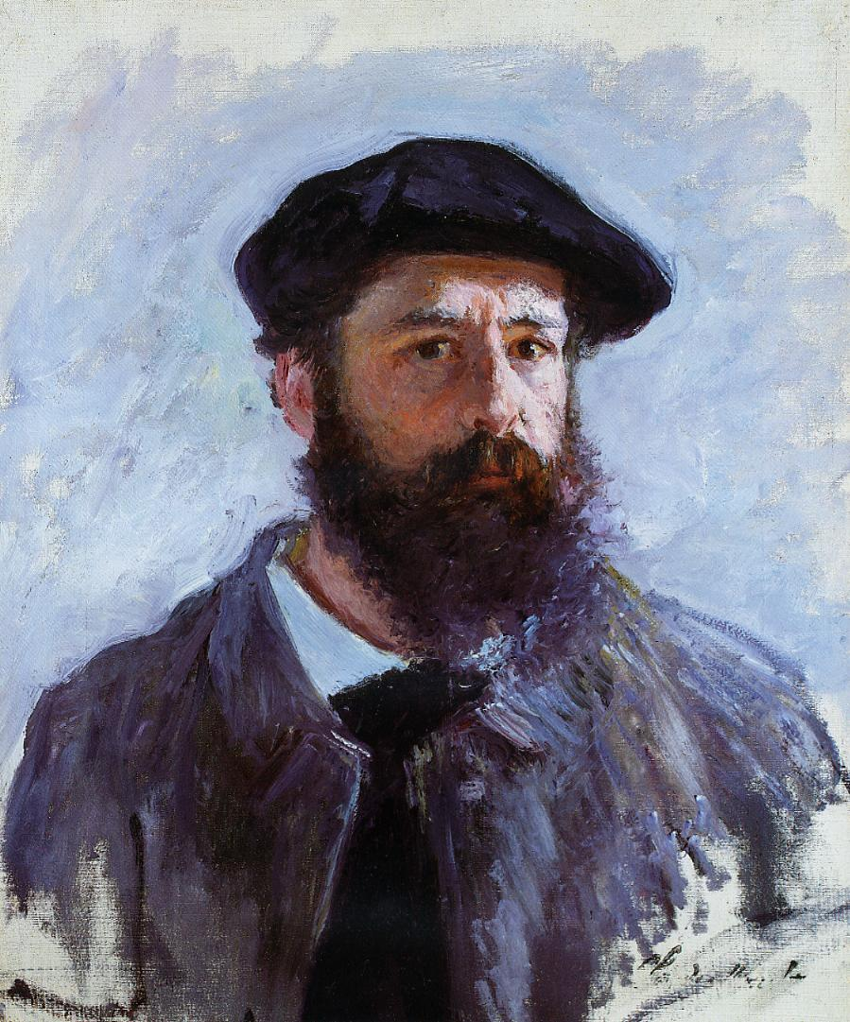
CLAUDE MONET (1840 – 1926)

Slide 14
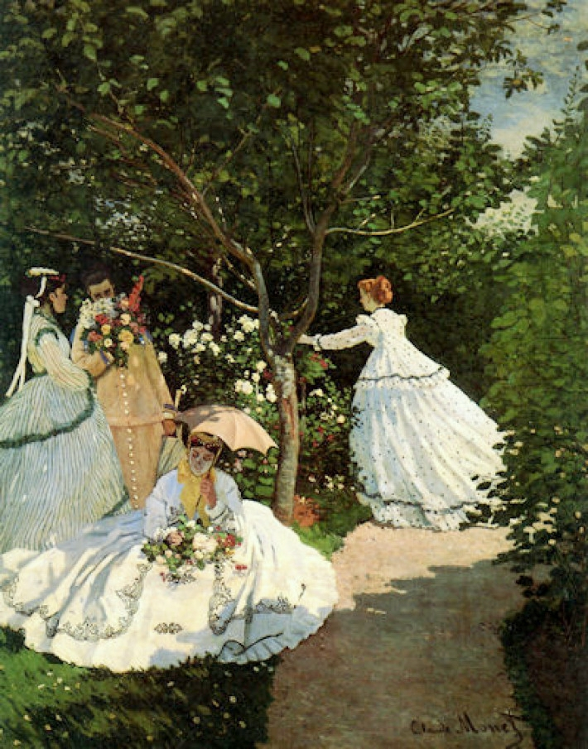
CLAUDE MONET
“Ladies in the Garden”
(1867)

Slide 15
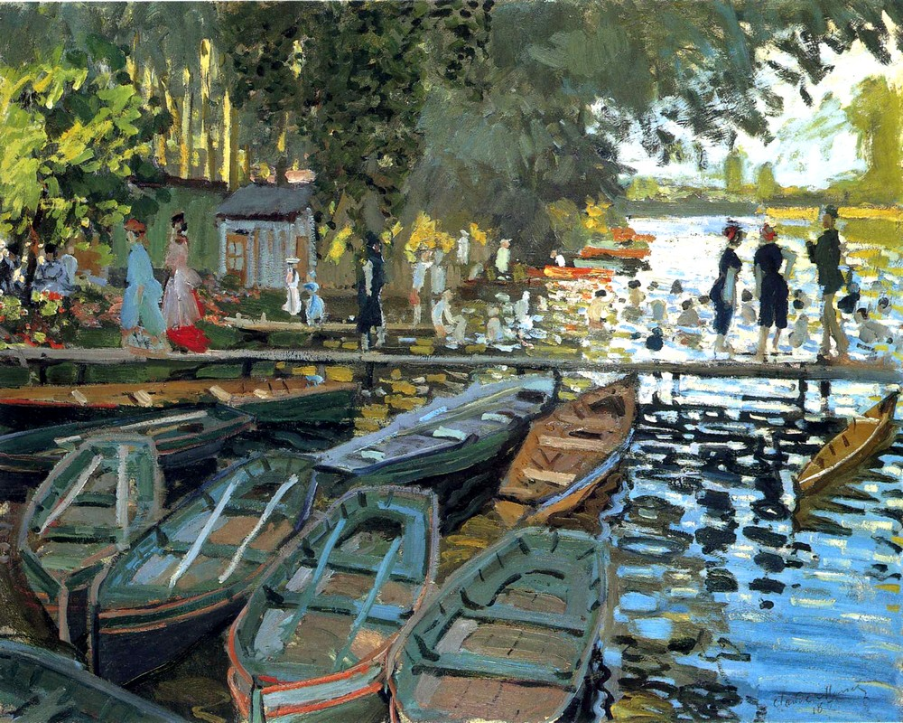
CLAUDE MONET
“Bathers At La Grenouillere (Frog Pond)”
(1869)

Slide 16
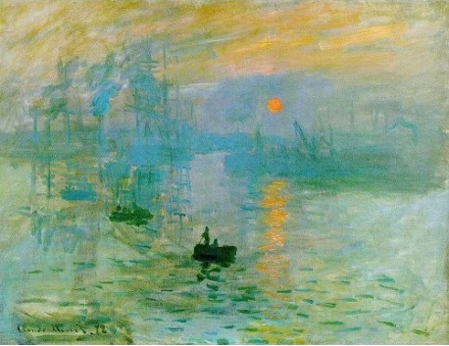
CLAUDE MONET
“Impression: Sunrise”
(1873)

Slide 17
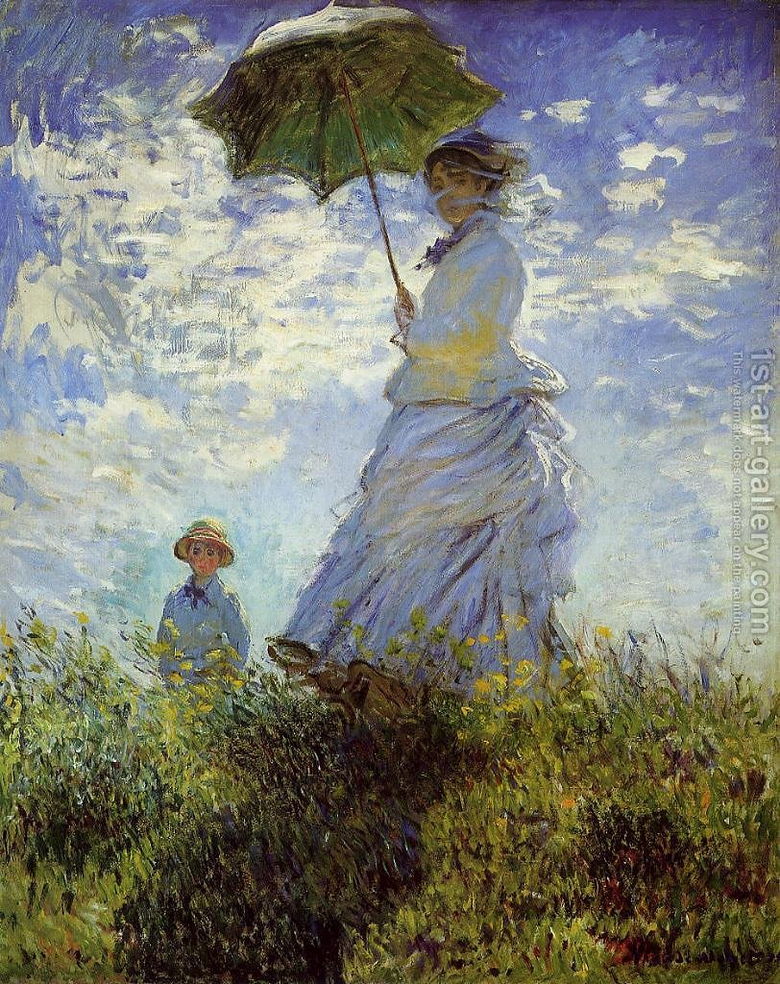
CLAUDE MONET
“The Promenade / Woman with a Parasol ”
(1875)

Slide 18
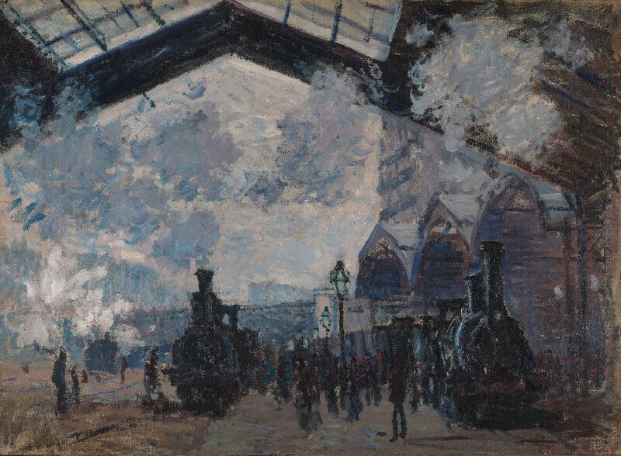
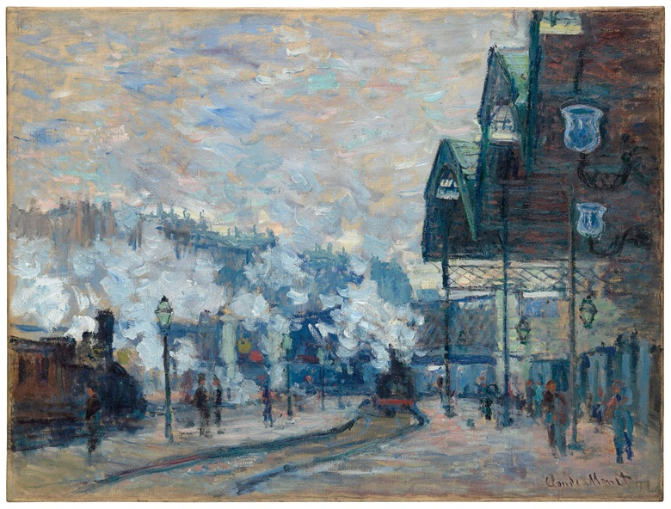
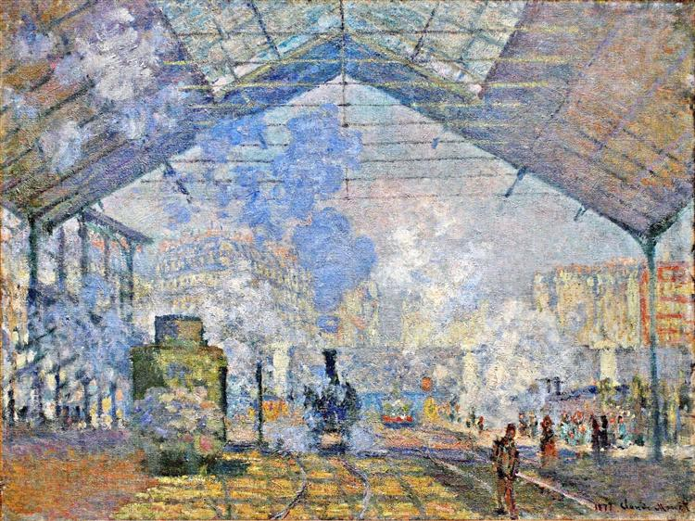
CLAUDE MONET
Series of “St. Lazare Station”

Slide 19
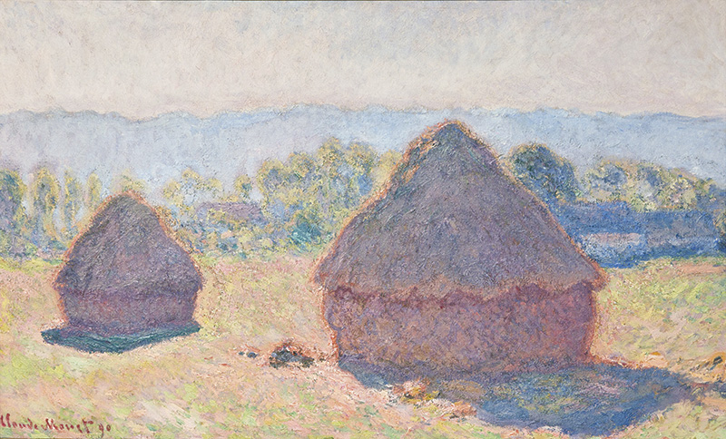
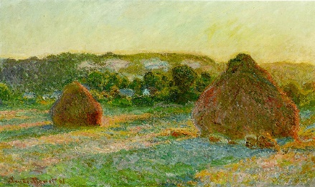
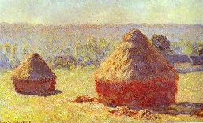
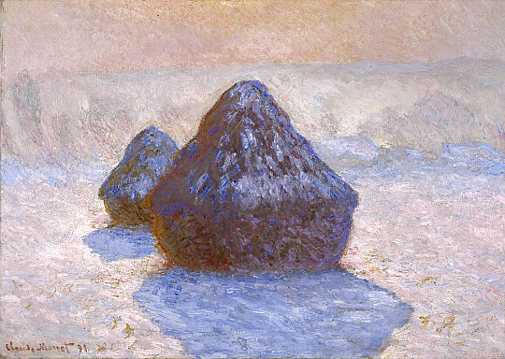
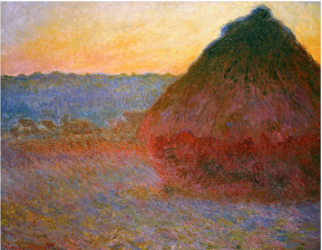
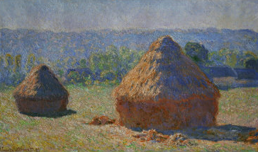
CLAUDE MONET
Series of “Hay Stacks”
First exhibited in 1891

Slide 20
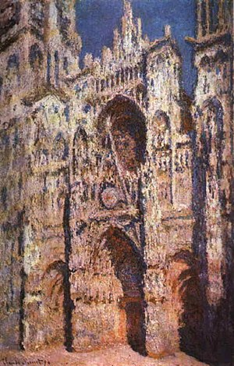
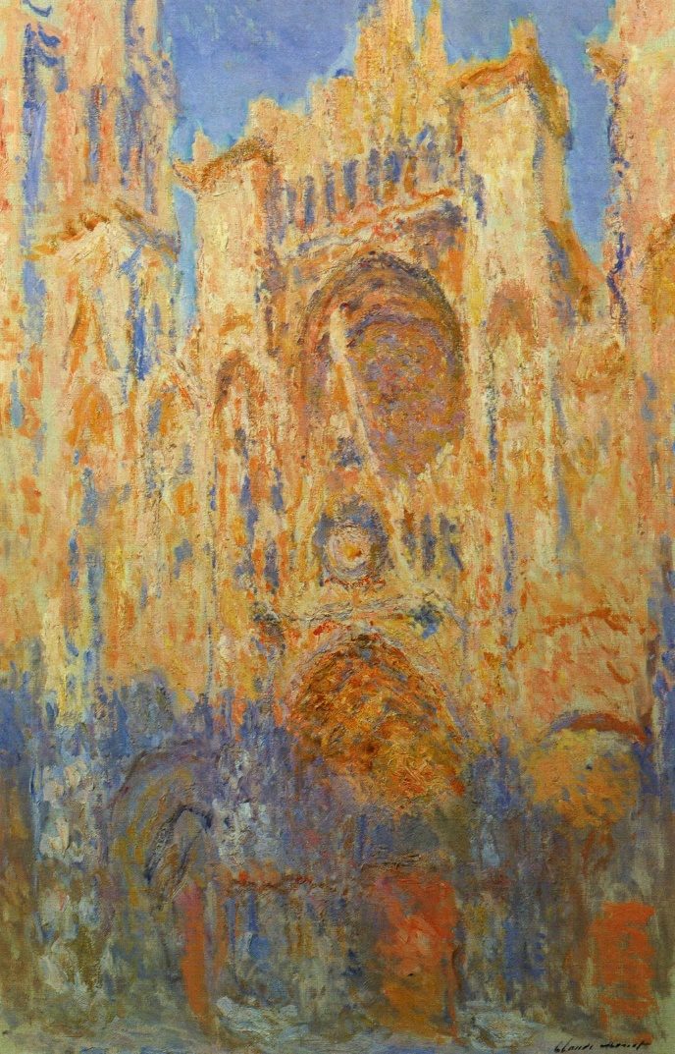
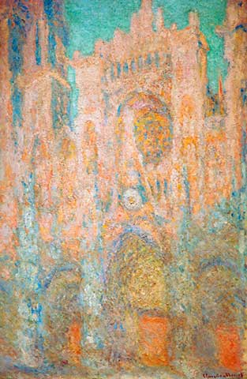
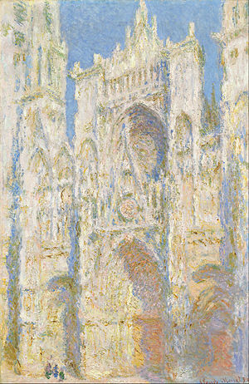
CLAUDE MONET
Series of “Rouen Cathedral”

Slide 21
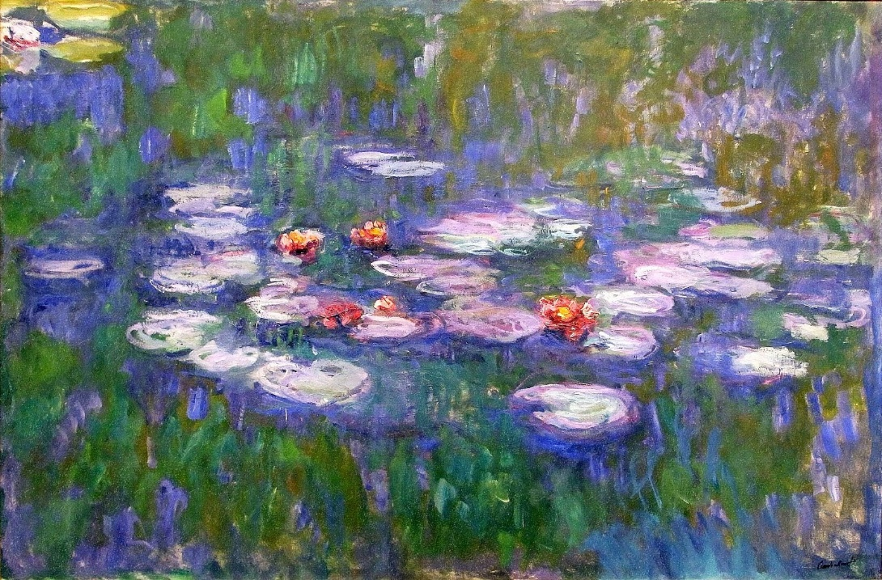
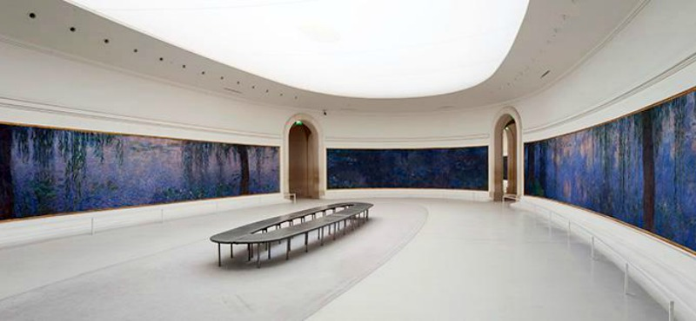
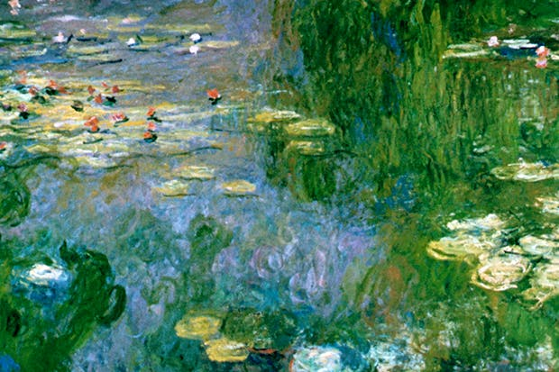
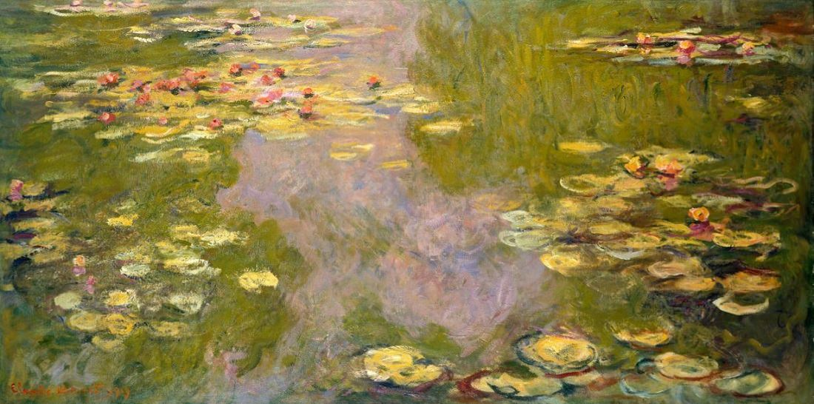
CLAUDE MONET Series of “Water Lilies” First exhibited in 1900

Slide 22
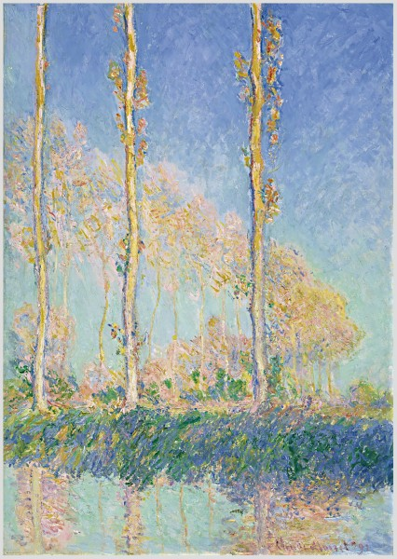
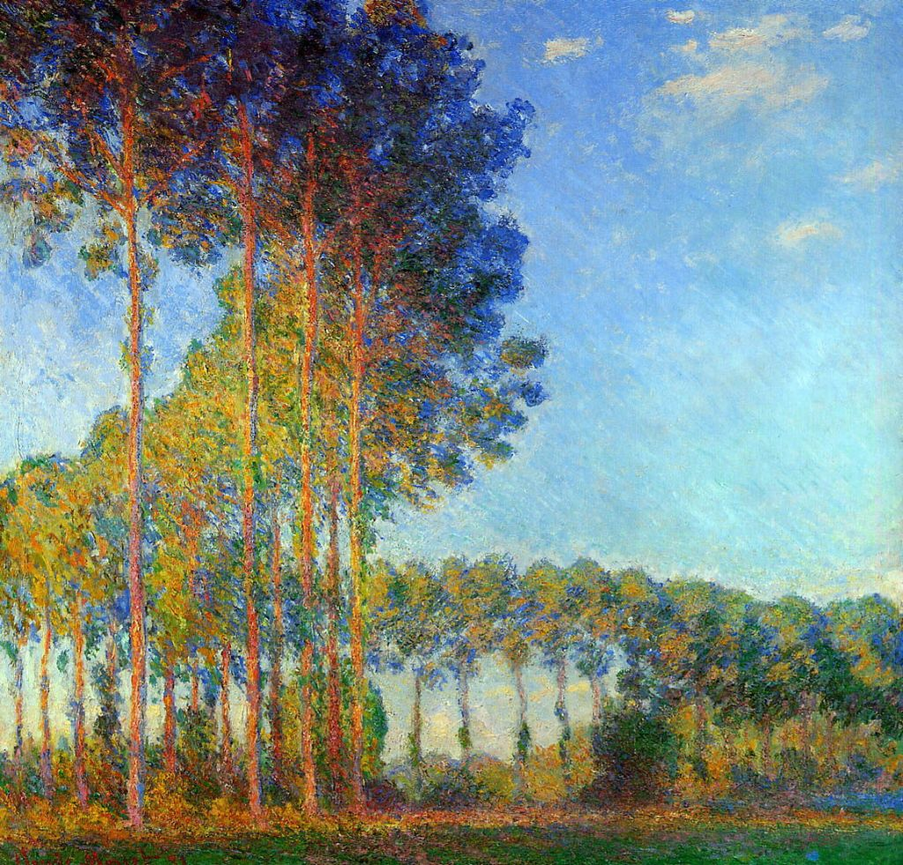
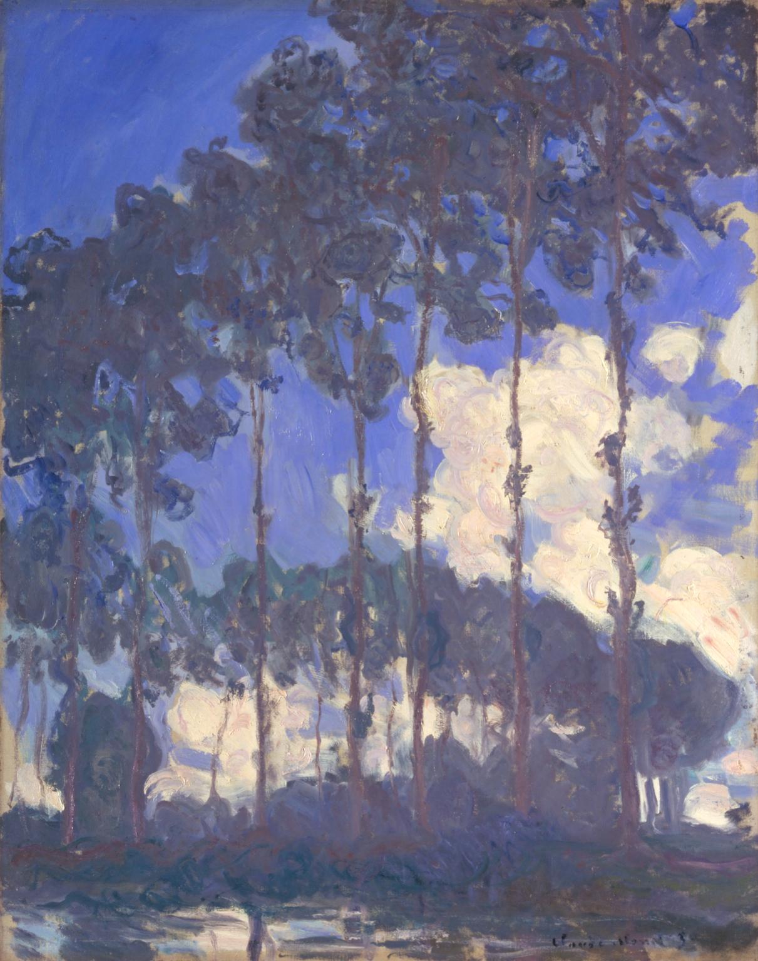
CLAUDE MONET
Series of “Poplars”

Slide 23
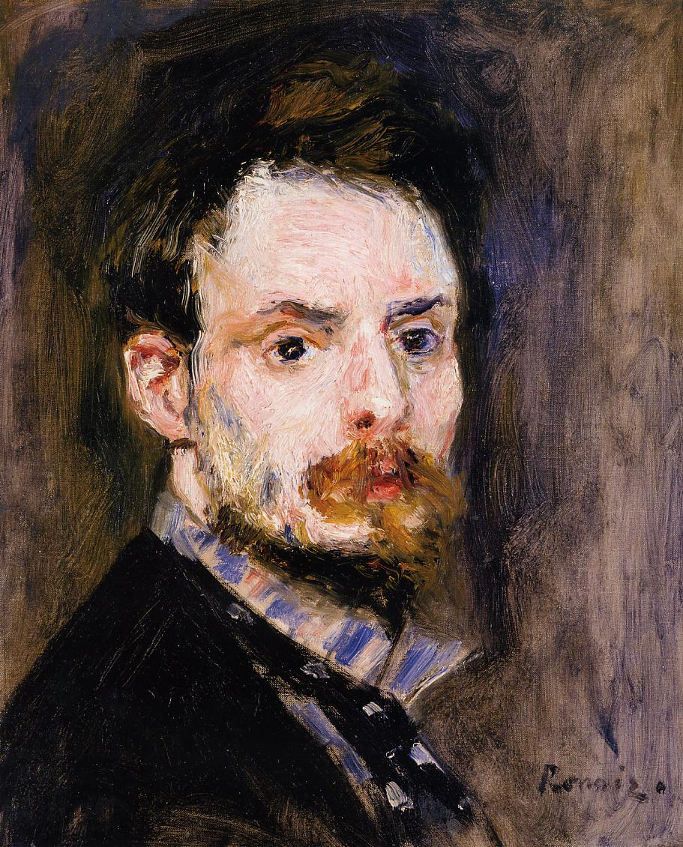
PIERRE-AUGUSTE RENOIR (1841 – 1919)

Slide 24
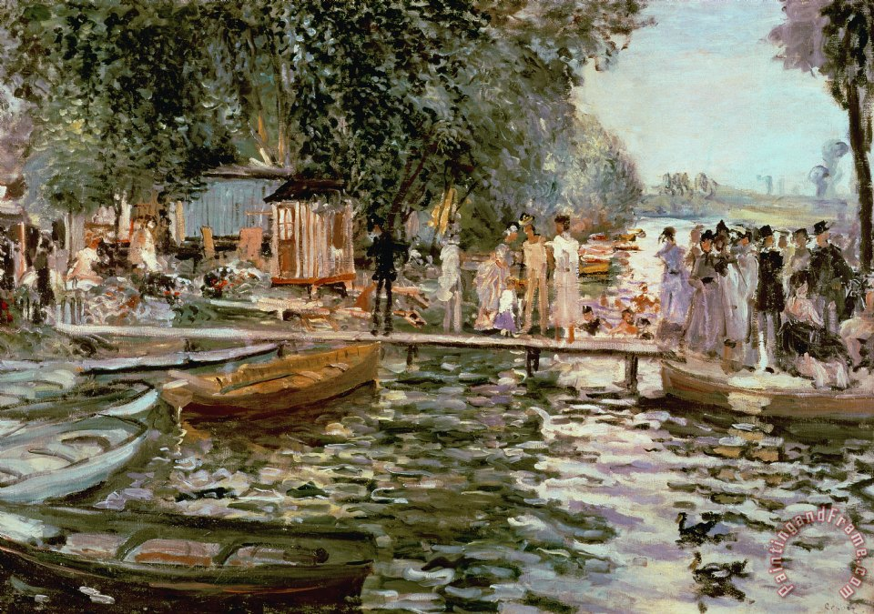
RENOIR
“La Grenouillere / Frog Pond”
(1869)

Slide 25
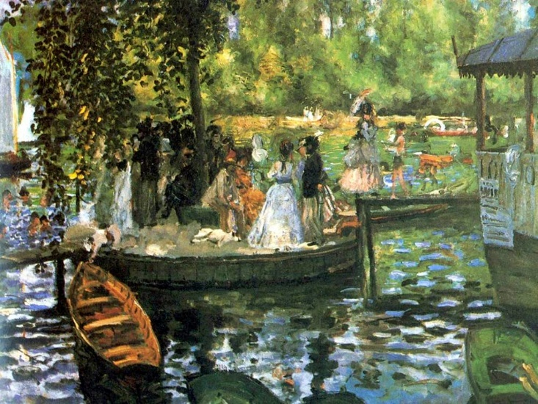
RENOIR
“La Grenouillere / Frog Pond”
(1869)

Slide 26
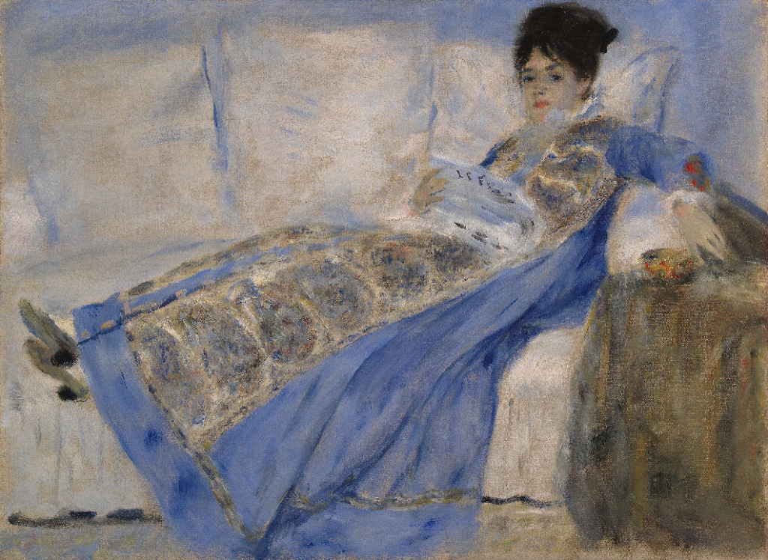
RENOIR
“Madame Claude Monet Lying on a Sofa”
(1872)

Slide 27
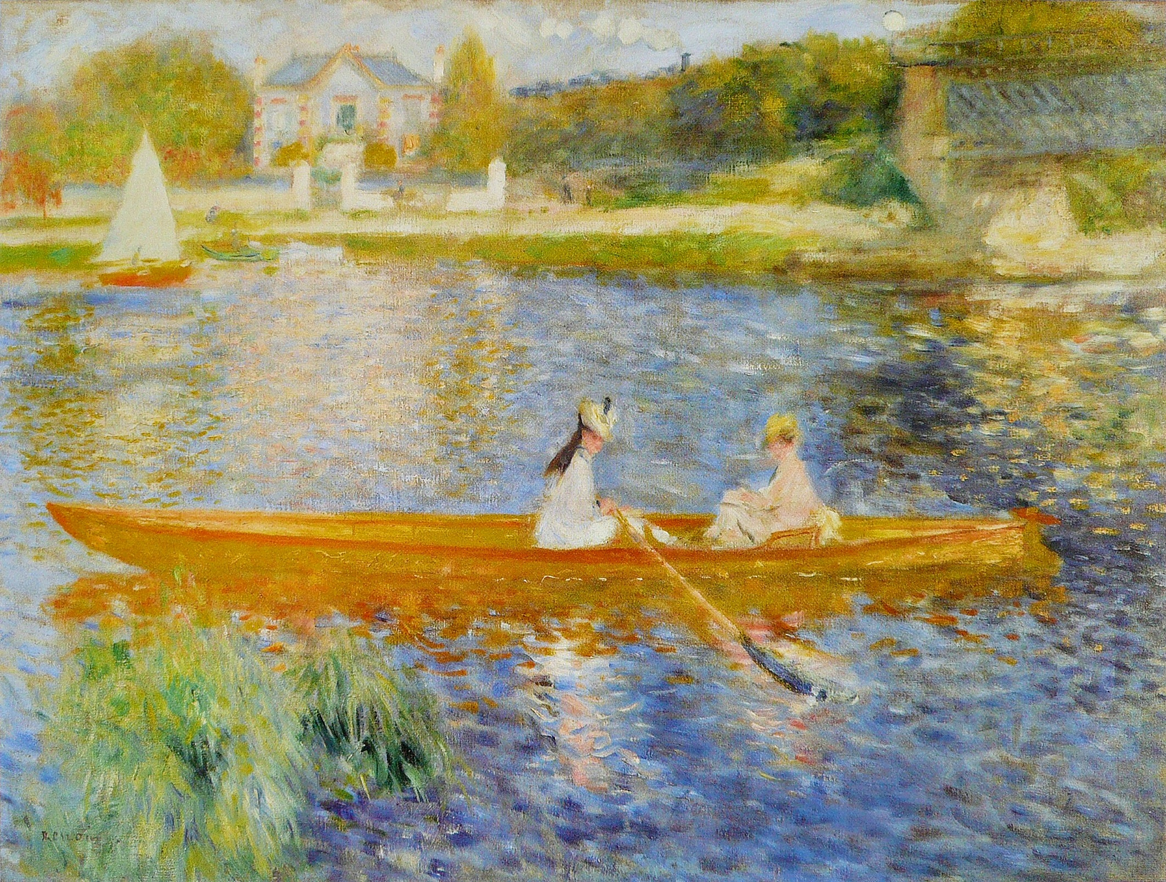
RENOIR
“The Skiff”
(1875)

Slide 28
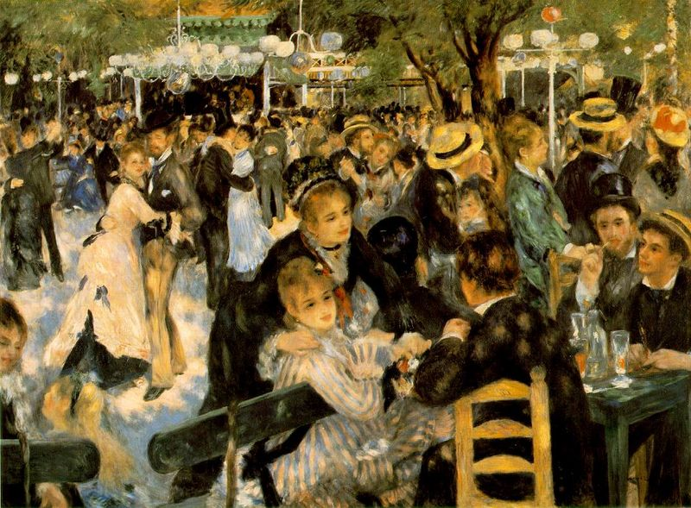
RENOIR
“Ball / Dance at the Moulin de la Galette”
(1876)

Slide 29
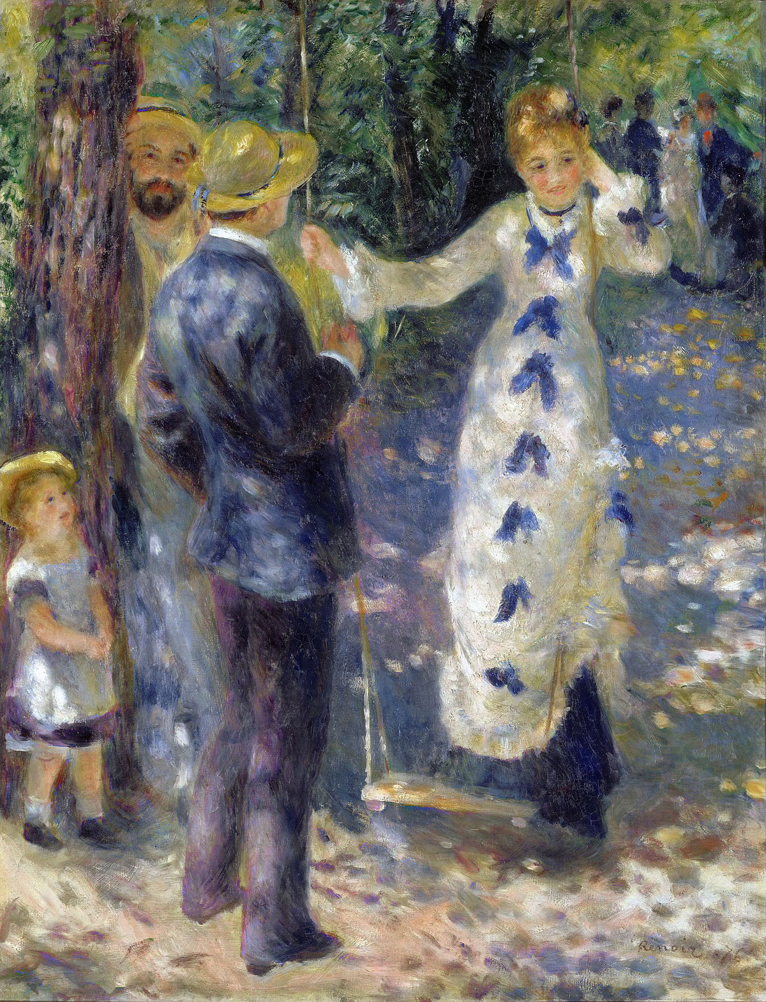
RENOIR
“The Swing”
(1876)

Slide 30
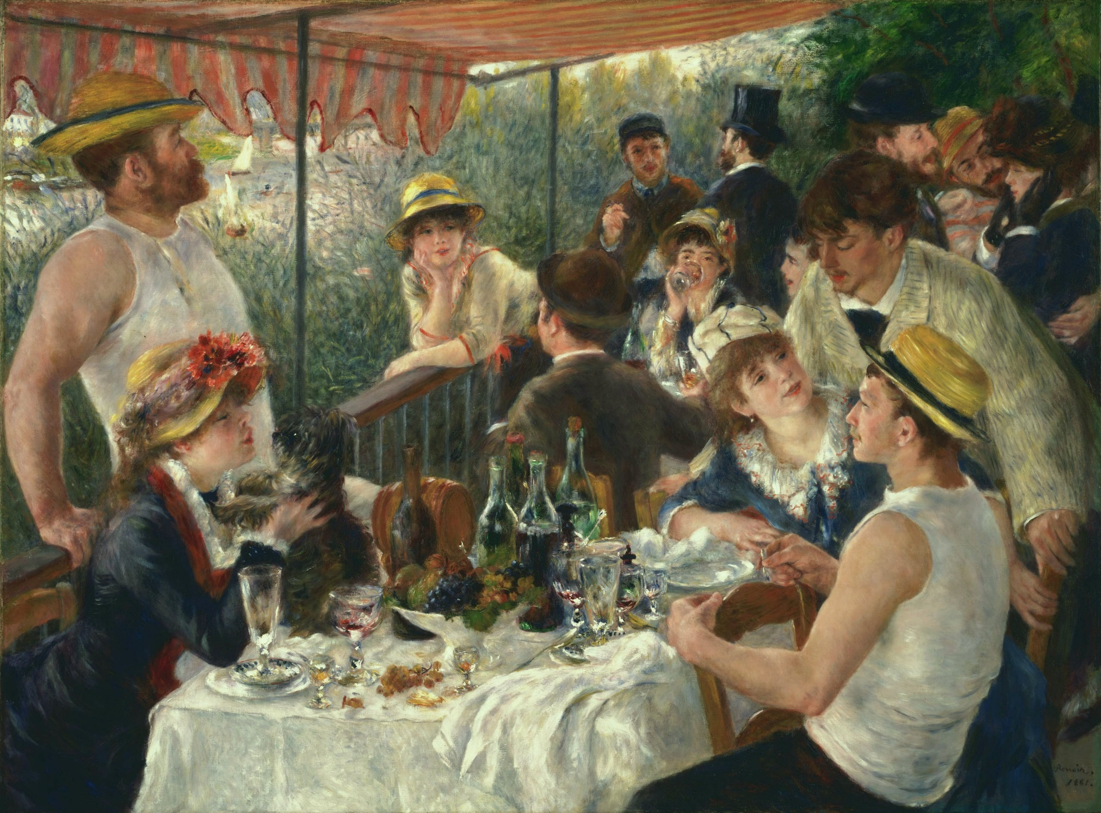
RENOIR
“Luncheon of the Boating Party”
(1881)

Slide 31
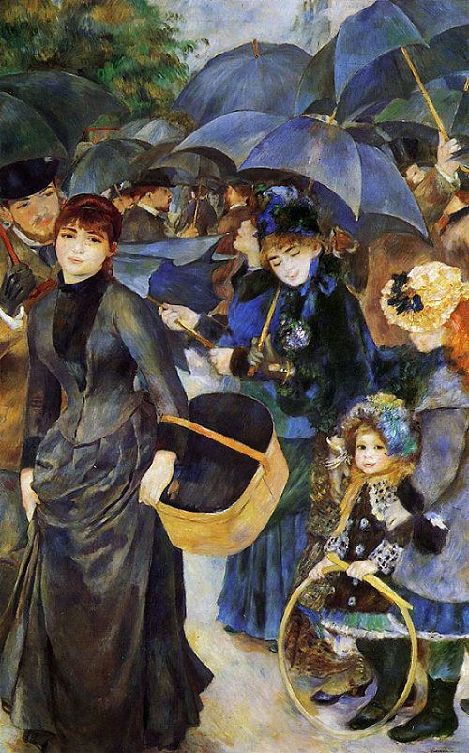
RENOIR
“The Umbrellas”
(1886)

Slide 32
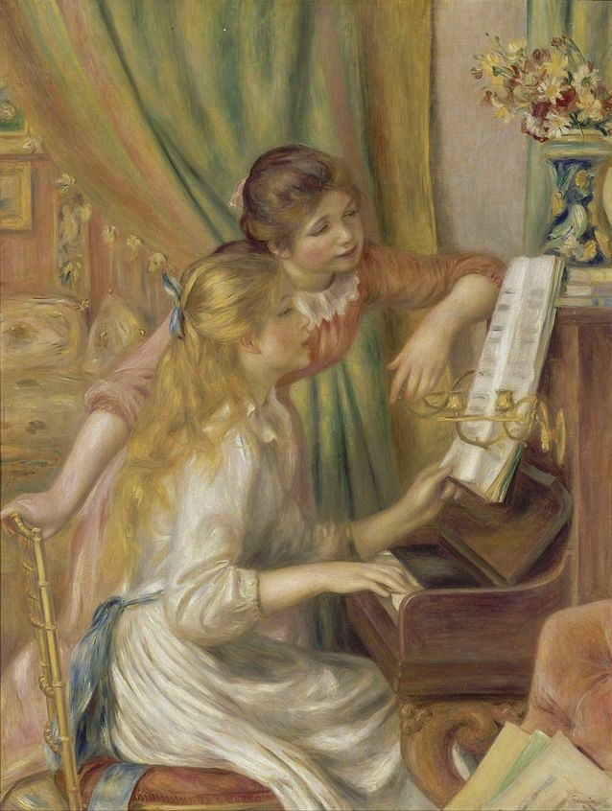
RENOIR
“Young Girls at the Piano”
(1892)

Slide 33
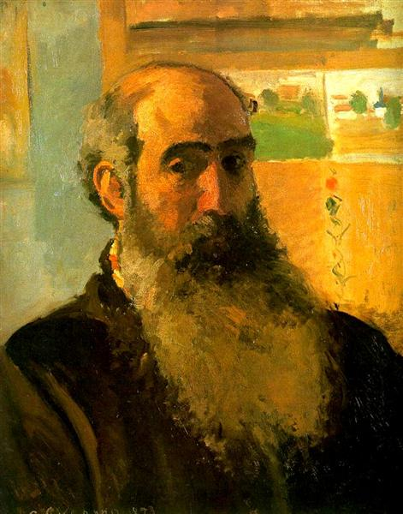
CAMILLE PISSARRO (1830 – 1903)

Slide 34
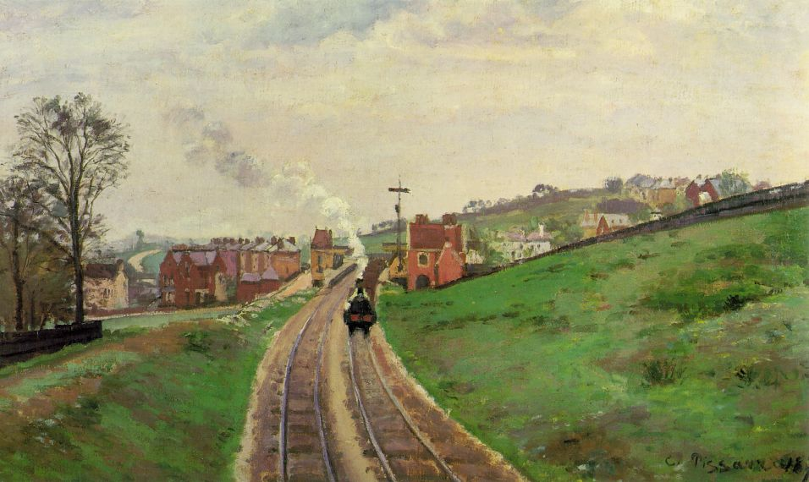
PISSARRO
“Lordship Lane Station, Dulwich” (1872)

Slide 35
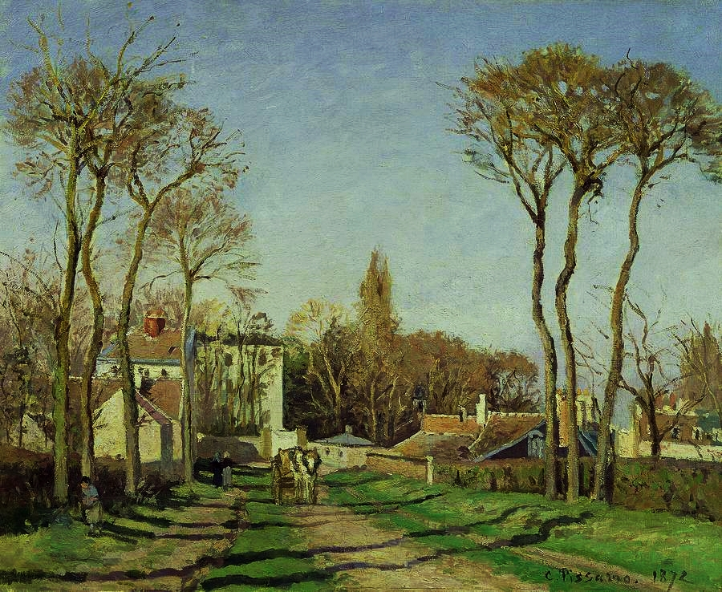
PISSARRO
“Entrance to the Village of Voisins”
(1872)

Slide 36
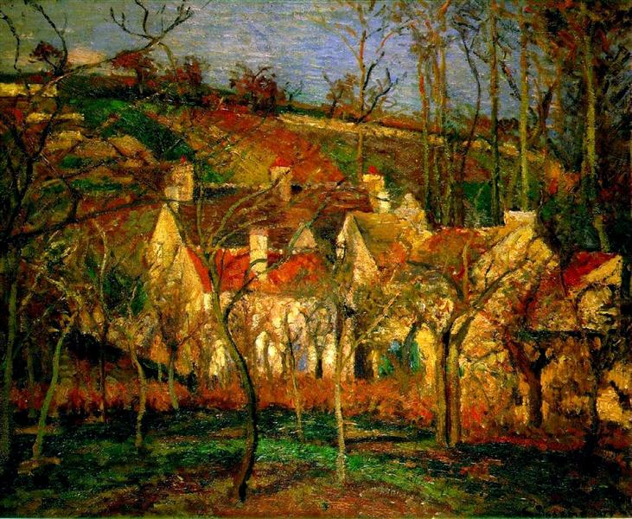
PISSARRO
“Red Roofs, Corner of a Village, Winter”
(1877)

Slide 37
PISSARRO
“Woman and Child Doing Needlework”
(1877)
PISSARRO
“Madame Pissarro Sewing near a Window” (1879)

Slide 38
PISSARRO
“Laundry and Mill at Osny”
(1884)

Slide 39
PISSARRO
“The Great Bridge, Rouen”
(1896)

Slide 40
PISSARRO
“Boulevard des Italiens Afternoon”
(1897)

Slide 41
PISSARRO
“Boulevard Montmartre Afternoon, in the Rain”
(1897)

Slide 42
ALFRED SISLEY (1839 – 1899)

Slide 43
SISLEY
“Snow at Louveciennes”
(1874)

Slide 44
SISLEY
“Inn at East Molesey with Hampton Court Bridge”
(1874)

Slide 45
SISLEY
“Misty Morning”
(1874)

Slide 46
SISLEY
“Flood at Port-Marly”
(1876)

Slide 47
SISLEY
“Autumn: Banks of the Seine near Bougival”
(undated)

Slide 48
SISLEY
“Road at the Forest Fringe of Fontainebleau”
(1883)

Slide 49
EDGAR DEGAS (1834 – 1917)

Slide 50
DEGAS
“The Orchestra at the Opera”
(1870)

Slide 51
DEGAS
Study of a Dancer Scratching her Back

Slide 52
DEGAS
“The Dance Class”
(1876)

Slide 53
DEGAS
“In the Café (Absinthe)”
(1876)

Slide 54
DEGAS
“The Rehearsal”
(1877)

Slide 55
DEGAS
“The Star / Dancer on the Stage”
(1877)

Slide 56
DEGAS
“The Racecourse”
(1880)

Slide 57
DEGAS
“Two Laundresses / Women Ironing”
(1884)

Slide 58
DEGAS
“Woman in a Tub”
(1885)

Slide 59
DEGAS
“Jockeys in the Rain”
(1886)

Slide 60
DEGAS
“Fourteen-Year-Old Dancer”
Cast in Bronze with Silk, Linen, Satin & Muslin
(1879)
DEGAS
“Dancer”
Cast in Bronze
(1888)

